Slide 1

Safe Sharing: Access Control for Cloud Stored Data
by
G. Ajay Kishore
Roll No. 204G1A0506
M. Mounika
Roll No. 204G1A0561
T. Harsha Sri
Roll No. 204G1A0536
B. Bhavana
Roll No. 204G1A0522
Under the guidance of
Mr. M. Narasimhulu M.Tech (Ph.D)
Assistant Professor
Department of Computer Science and Engineering
Srinivasa Ramanujan Institute of Technology
(Autonomous)
2023 - 2024

Slide 2

Contents
Review-0 comments
Abstract
Problem statement
Objectives of Project
Literature survey for first objective
Objective-1 (Design & Implementation)
Objective-2 (Design & Implementation)
Literature survey for second objective
Proposed Work
References
GitHub Link
Queries

Slide 3
Review-1 Comments
What are the algorithms you have used?
What is SSE?
What is the purpose of using symmetric encryption?

Slide 4
Abstract
Over the past few years, cloud computing has grown to an extent that affects the day-to-day life of almost everyone. From big corporations to casual internet users the cloud has become an integral part of our lives. However, many users still feel reluctant about outsourcing their personal files since cloud services are hosted and run by third untrusted parties and thus, the files are vulnerable to internal attacks.
So, this project approach is to address these concerns, focusing on symmetric encryption of data and store in untrusted clouds, by combining symmetric encryption techniques with access control policies, ensuring data remains confidential even when stored in untrusted cloud environments, which specifies who can access what parts of encrypted data.
Keywords: Encryption, Untrusted parties, Access Control.

Slide 5
Problem Statement
The increase of data breaches in cloud computing puts all users at risk of
business problems, highlighting the need to improve security measures.
To mitigate the growing risks of data threats faced by users in cloud
Environment, proactive measures are essential.

Slide 6
Objectives of Project
To create an user interface and implementing searchable encryption on the text file uploaded by the user.
To implement the access control scheme and addressing the problem of revocation by using cryptographic techniques.

Slide 7
Literature survey for First objective
[1] In this paper, the traditional system says that the cloud service provider will encrypt the user’s data and stores in it which is not acceptable by the user because the cloud services can access their data. So to address this problem , they have proposed symmetric searchable encryption where data encrypted before sending into cloud. Here, only user can encrypt and decrypt the document by using encrypted Keyword. The Encrypted Keyword can be generated by the secret key of the user.

Slide 8
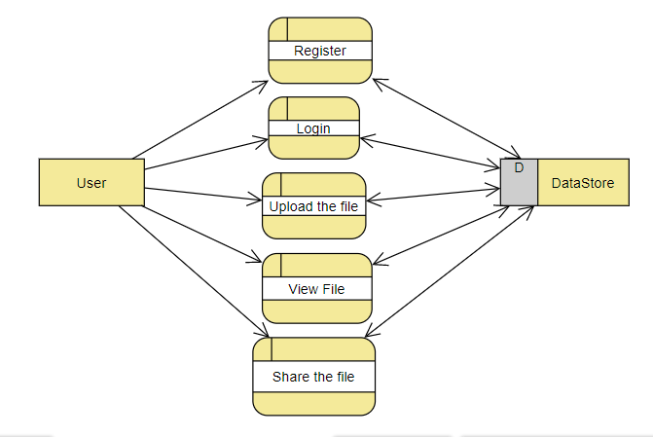
Design and Implementation for first objective

Slide 9
Design and Implementation for first objective
CLASS DIAGRAM

Slide 10
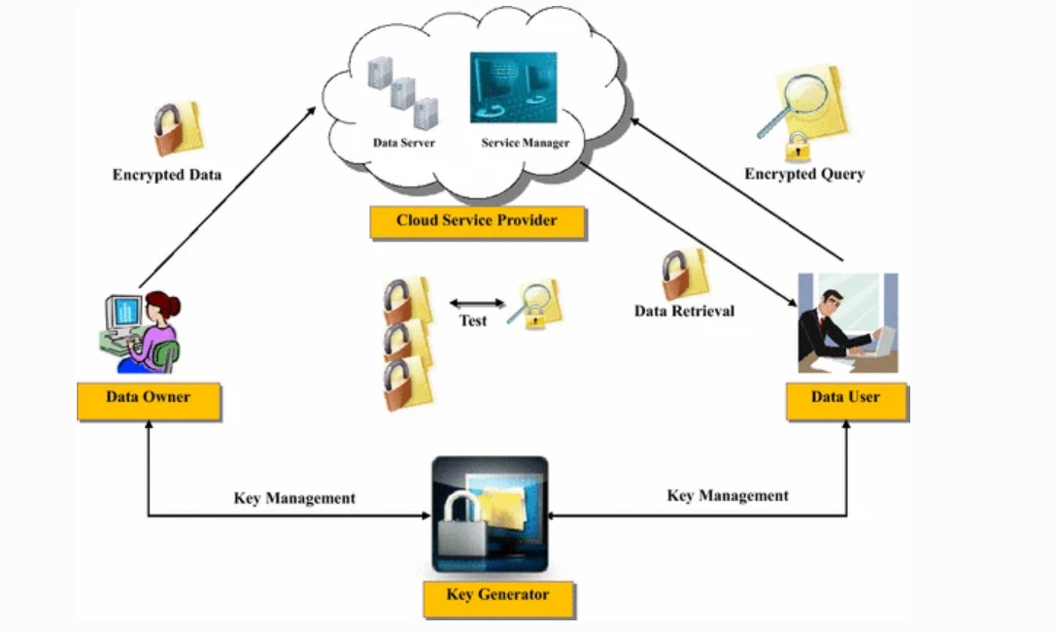
Design and Implementation for first objective
FLOW DIAGRAM

Slide 11
Design and Implementation for first objective
Symmetric Searchable Encryption Algorithm
KeyGen (1^{k}): It inputs a security parameter k and outputs a Secret Key SK.
IndexGen(SK,F): It takes a secret key SK and set of files F and generates an Index I for F.
Trapdoor(SK,w): The Algorithm takes secret key SK, Keyword W and generates a trapdoor t_{w} for w. // Where w is present in file set F.
Search(I, t_{w}): It is run by a server taking trapdoor t_{w} and Index I and returns the file F(w).

Slide 12
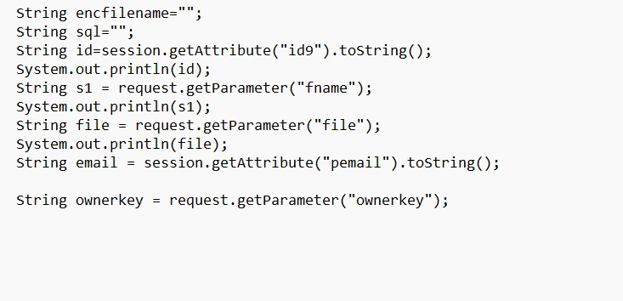

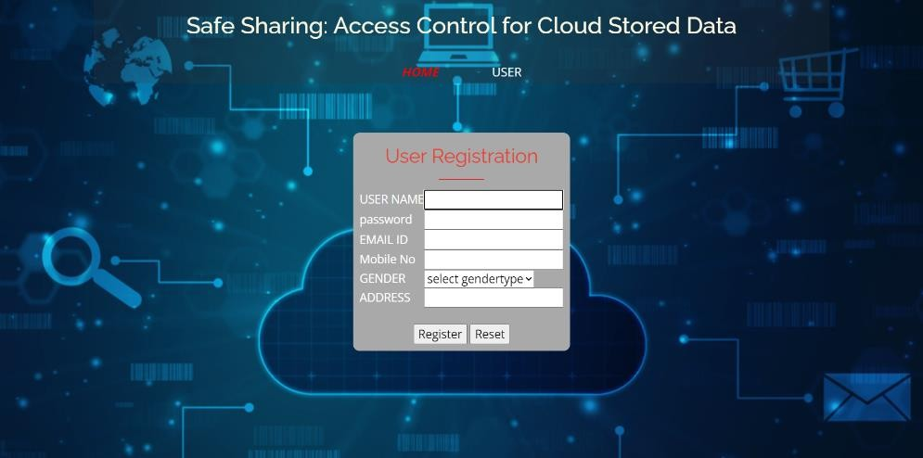
Design and Implementation for first objective

Slide 13
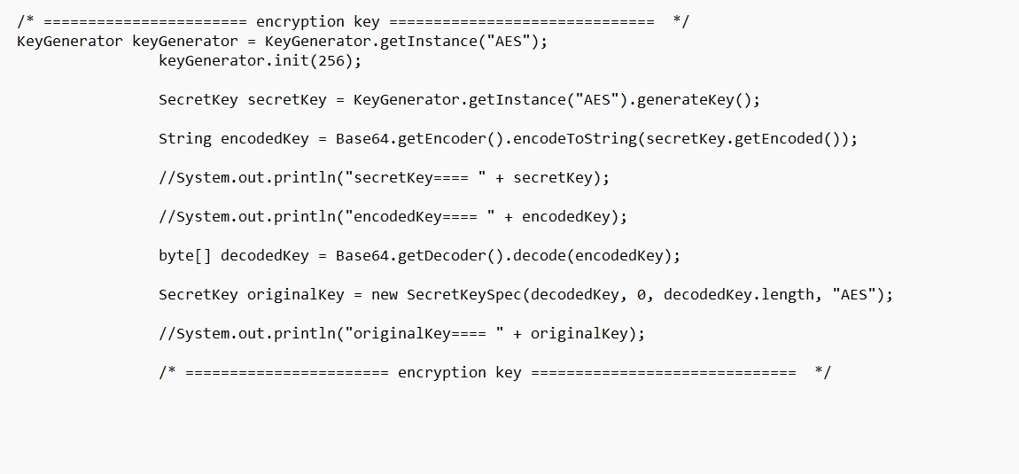
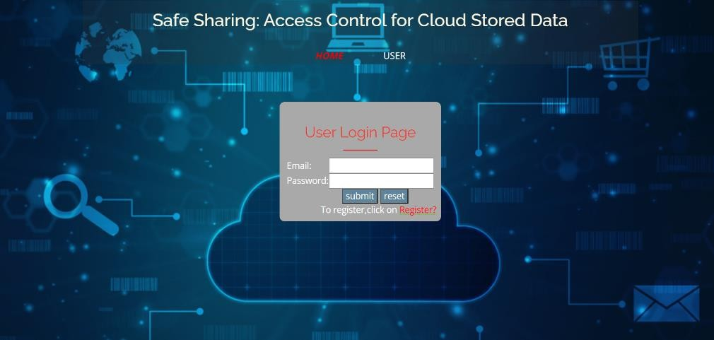
Design and Implementation for first objective

Slide 14
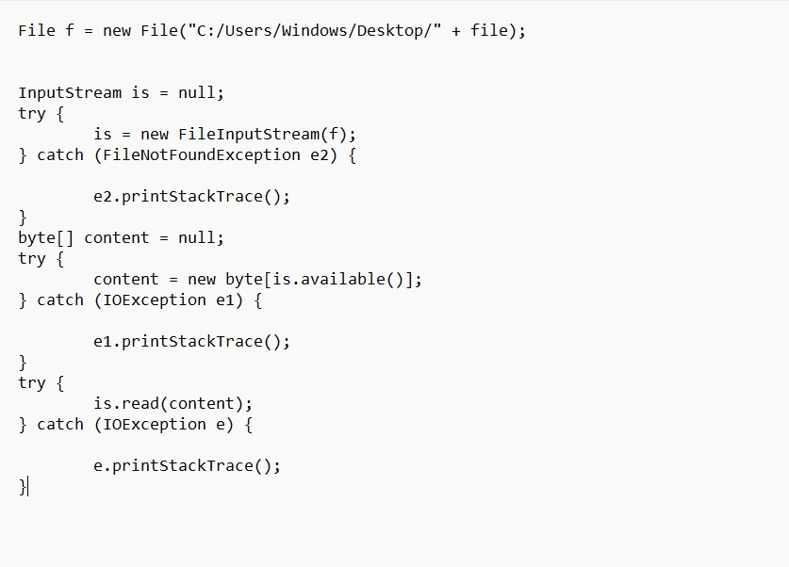
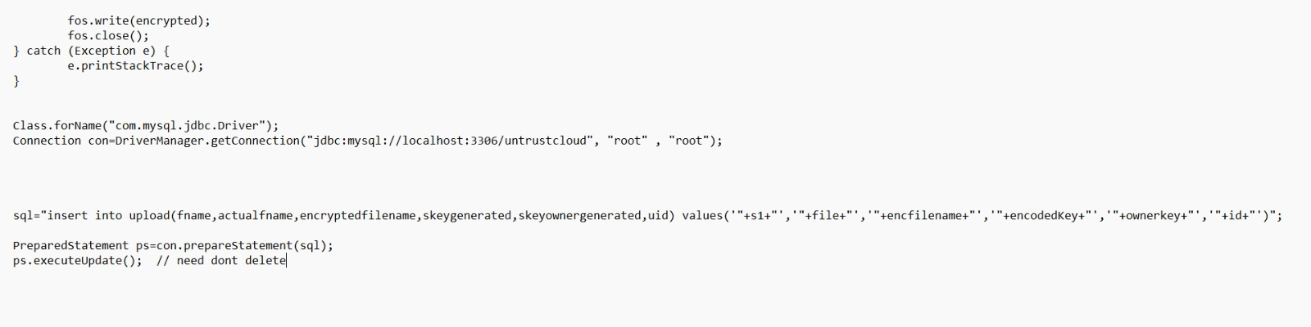
Design and Implementation for first objective

Slide 15
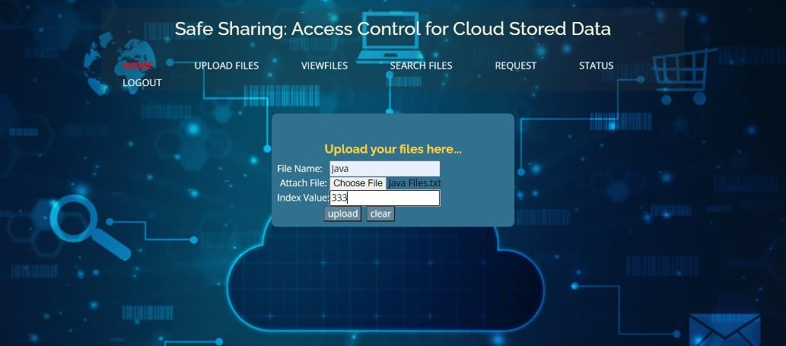
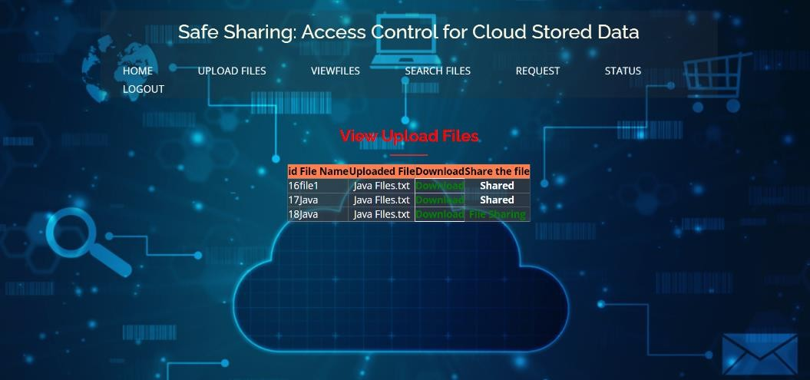
Design and Implementation for first objective

Slide 16
Literature survey for Second objective
[2] In this paper, the system says that In several distributed systems a user should only be able to access data if a user posses a certain set of credentials or attributes. Currently, the only method for enforcing such policies is to employ a trusted server to store the data and mediate access control. However, if any server storing the data is compromised, then the confidentiality of the data will be compromised. In this paper we present a system for realizing complex access control on encrypted data that we call ciphertext-policy attribute-based encryption.

Slide 17
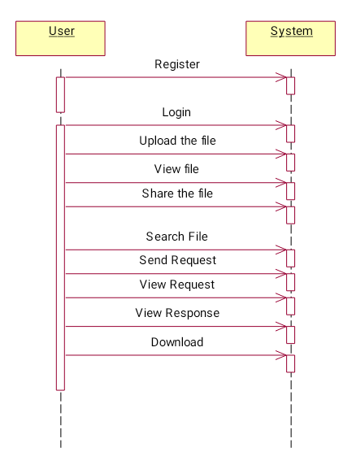
Design and Implementation for second objective

Slide 18
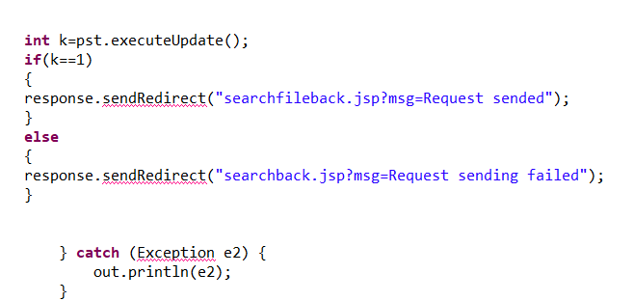
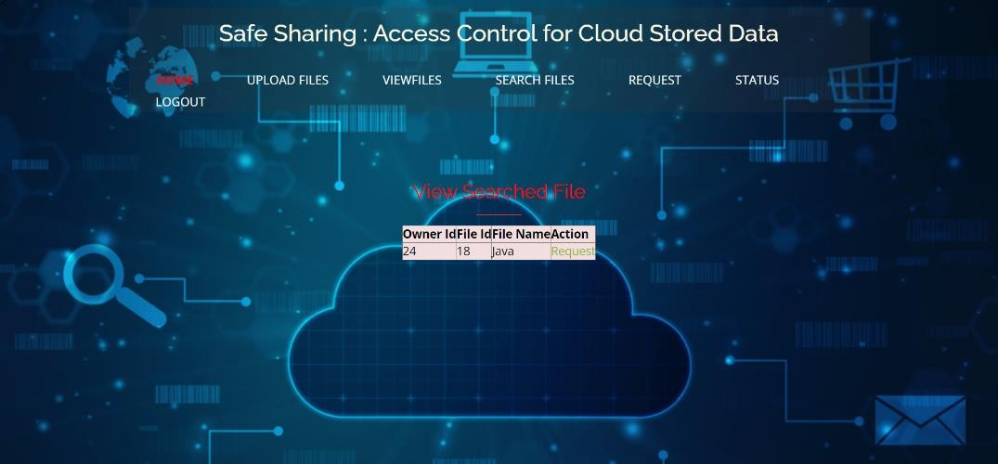
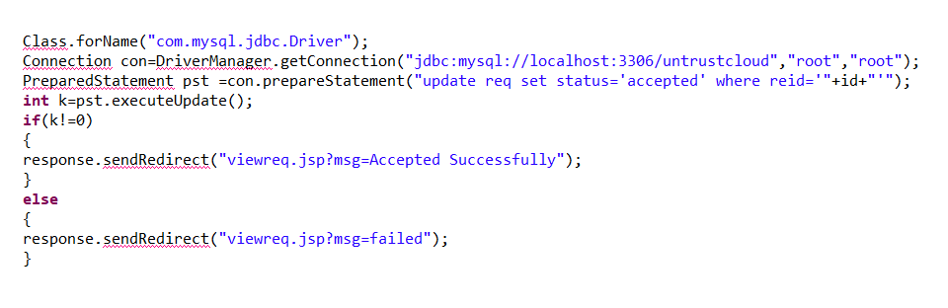
Design and Implementation for second objective

Slide 19
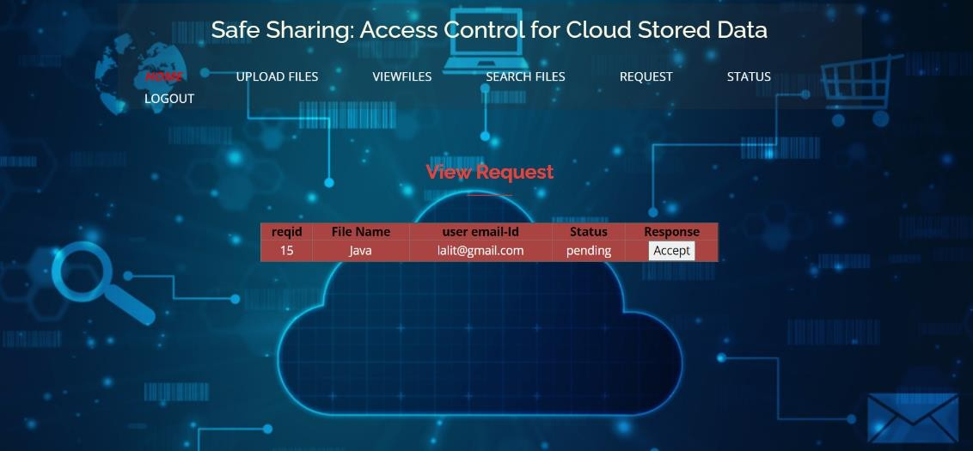
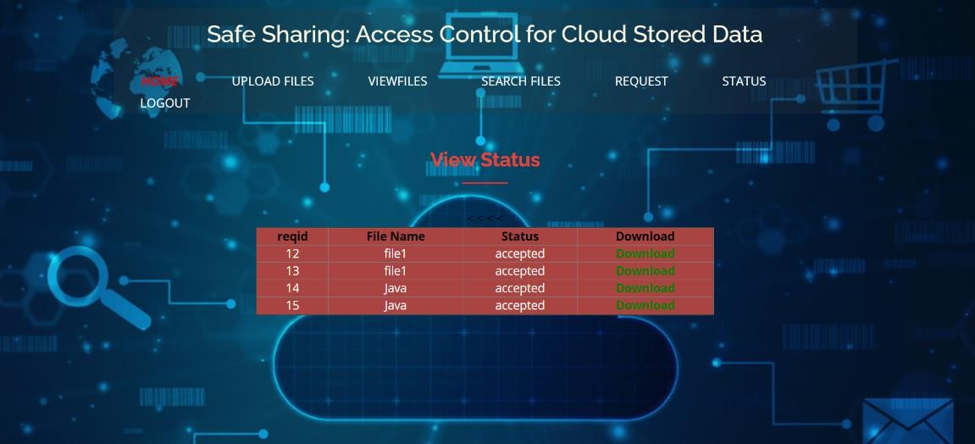
Design and Implementation for second objective

Slide 20
Proposed System
In proposed system, we use these two cryptographic techniques that secure the data storage in cloud-based environments ,to design a hybrid encryption scheme based on ABE and SSE in such a way that we utilize the best out of both of them.
The data can be encrypted into cipher text before moving into cloud by using symmetric encryption.
The revocation mechanism and an access control bounded by policy, that ensures data security.

Slide 21
References
[1] Geong Sen Poh, Ji-Jian Chin, Wei-Chuen Yau, Kim-Kwang Raymond Choo, and Moesfa Soeheila Mohamad. 2017. “Searchable symmetric encryption: Designs and challenges”. ACM Comput. Surv. 50, 3, Article 40 (May 2017)
[2] J. Bethencourt, A. Sahai, and B. Waters, ‘‘Ciphertext-policy attribute-based encryption,’’ in Proc. IEEE Symp. Secur. Privacy (SP). Washington, DC, USA: IEEE Computer Society, 2007, pp. 321–334.
[3] A.Bakas and A. Michalas, “The Cloud we Share: Access Control on Symmetrically Encrypted Data in Untrusted Clouds” IEEE Access(Volume 8), 2020.

Slide 22
References
[4] A. Boldyreva, V. Goyal, and V. Kumar, ‘‘Identity-based encryption with efficient revocation,’’ in Proc. 15th ACM Conf. Comput. Commun. Secur. (CCS), New York, NY, USA, 2008, pp. 417–426.
[5] J. Bethencourt, A. Sahai, and B. Waters, ‘‘Ciphertext-policy attribute-based encryption,’’ in Proc. IEEE Symp. Secur. Privacy (SP). Washington, DC, USA: IEEE Computer Society, 2007, pp. 321–334.

Slide 23
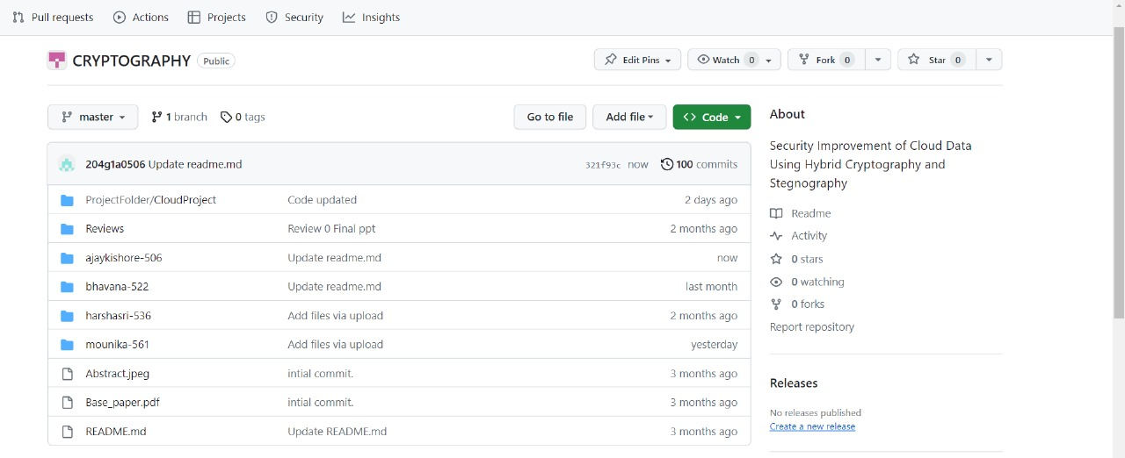
Git Hub Dashboards of each student
https://github.com/SRIT-CSE/CRYPTOGRAPHY.git

Slide 24
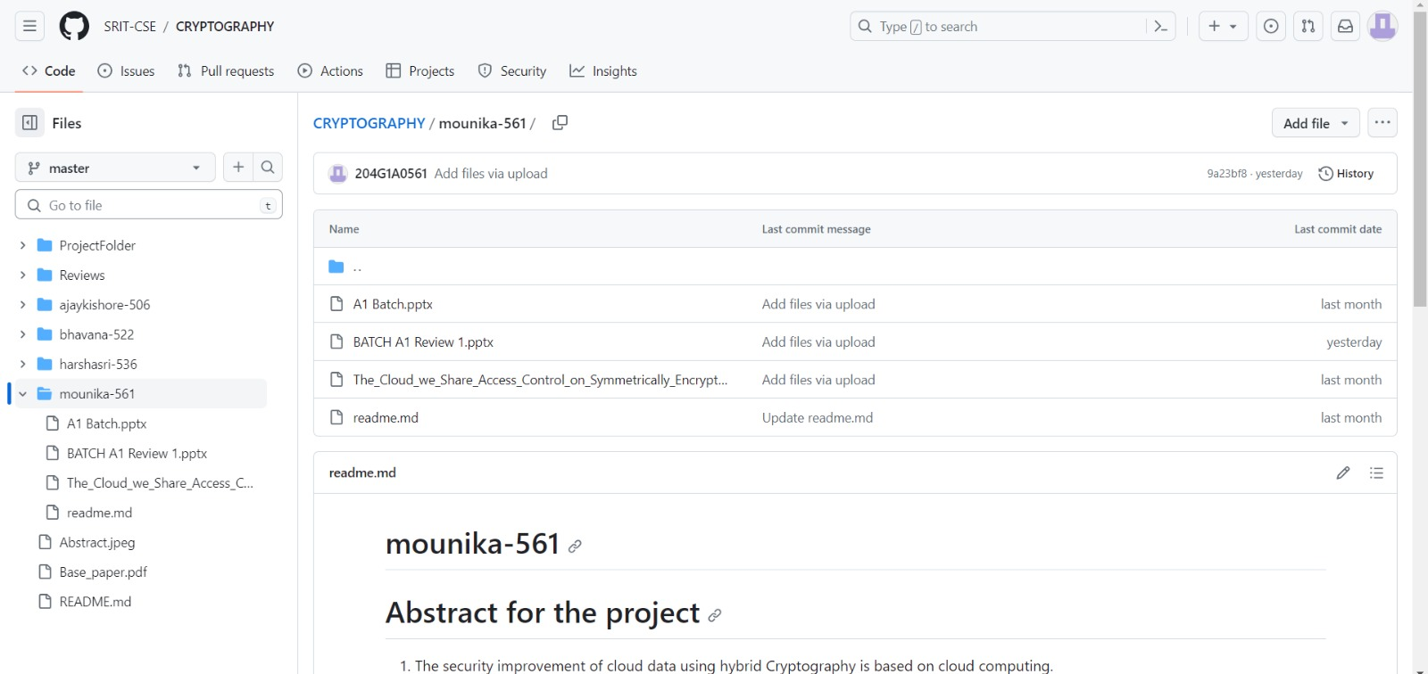
Git Hub Dashboards of each student
https://github.com/SRIT-CSE/CRYPTOGRAPHY.git

Slide 25
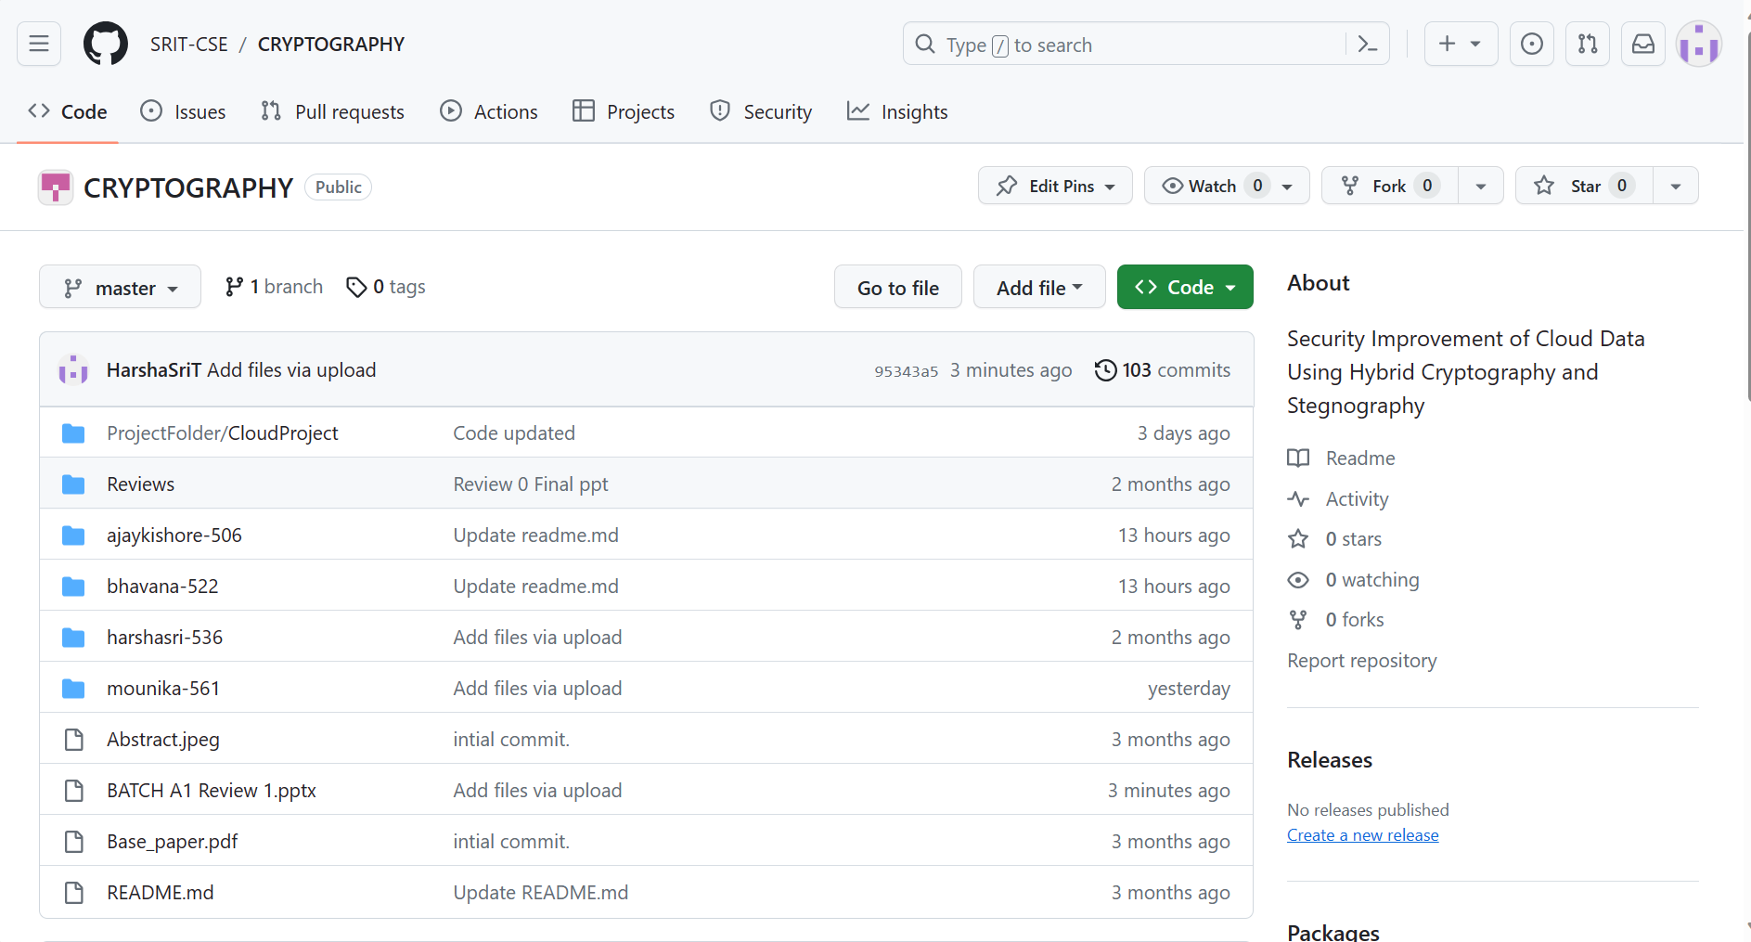
Git Hub Dashboards of each student
https://github.com/SRIT-CSE/CRYPTOGRAPHY.git

Slide 26
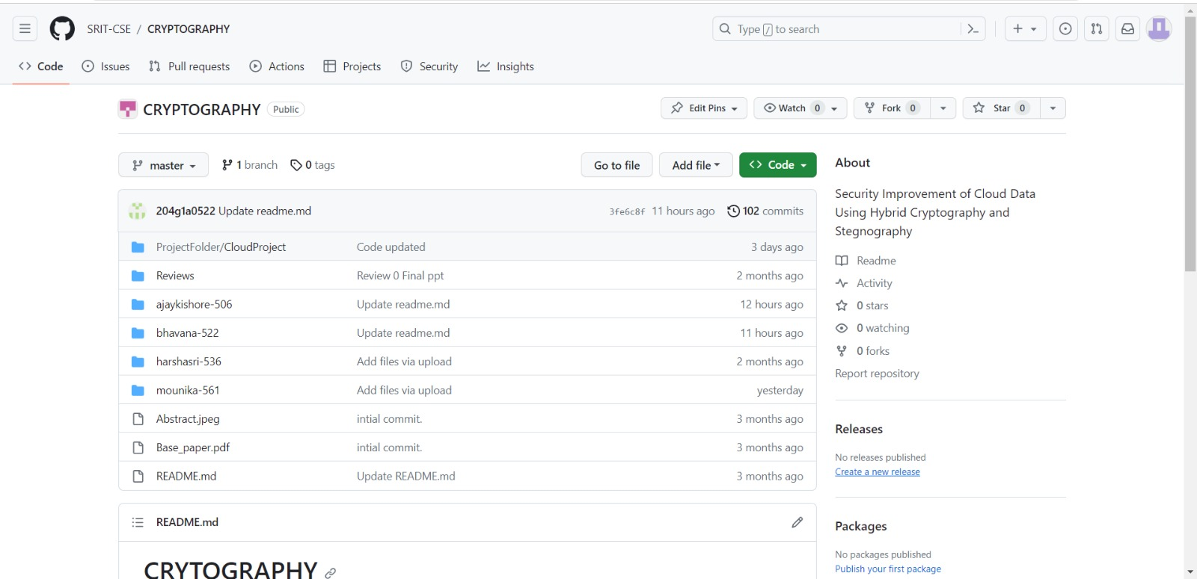
Git Hub Dashboards of each student
https://github.com/SRIT-CSE/CRYPTOGRAPHY.git

Slide 27
Any Queries?

